Slide 1
Unit 4: Differential Calculus
Total derivatives for single variable functions
Partial derivatives for multivariable functions
Gradient and gradient descent
Auto-differentiation

Slide 2
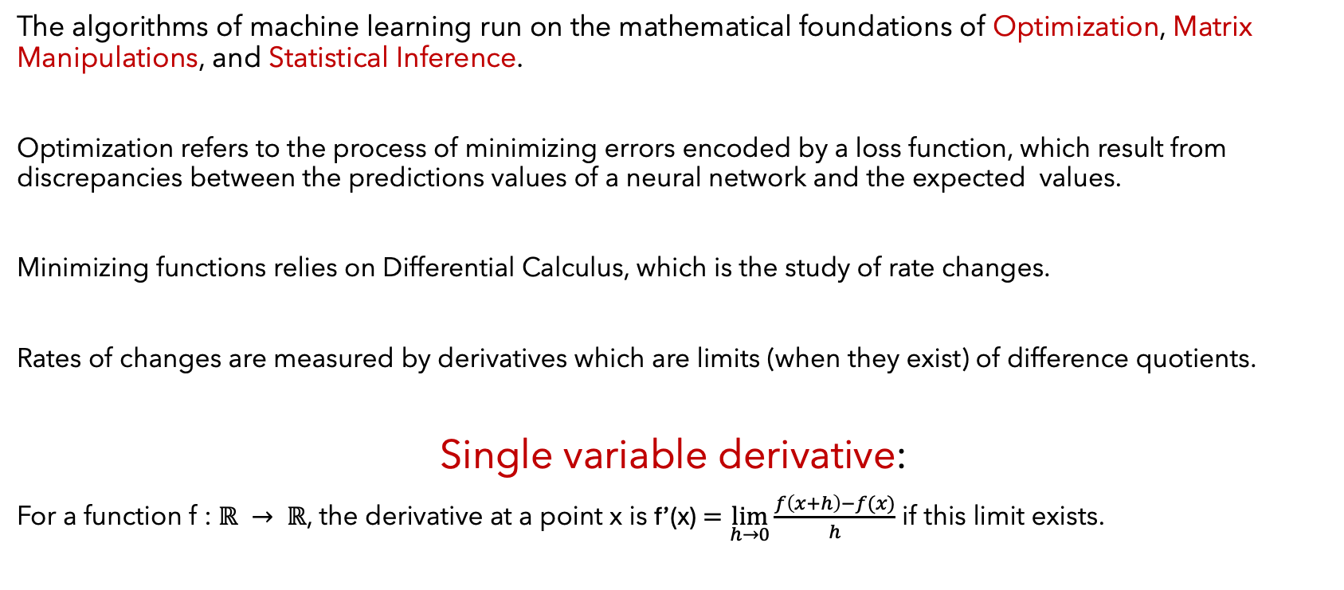
Differential Calculus
The algorithms of machine learning run on the mathematical foundations of Optimization, Matrix Manipulations, and Statistical Inference.
Optimization refers to the process of minimizing errors encoded by a loss function, which result from discrepancies between the predictions values of a neural network and the expected values.
Minimizing functions relies on Differential Calculus, which is the study of rate changes.
Rates of changes are measured by derivatives which are limits (when they exist) of difference quotients.
Single variable derivative:
For a function f : $ℝ → ℝ$, the derivative at a point x is f’(x) $=\lim_{h→0}{\frac{f\left(x+h\right)−f(x)}{h}}$ if this limit exists.

Slide 3
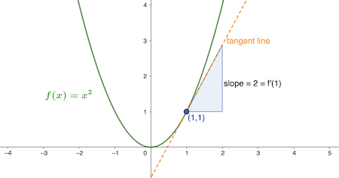
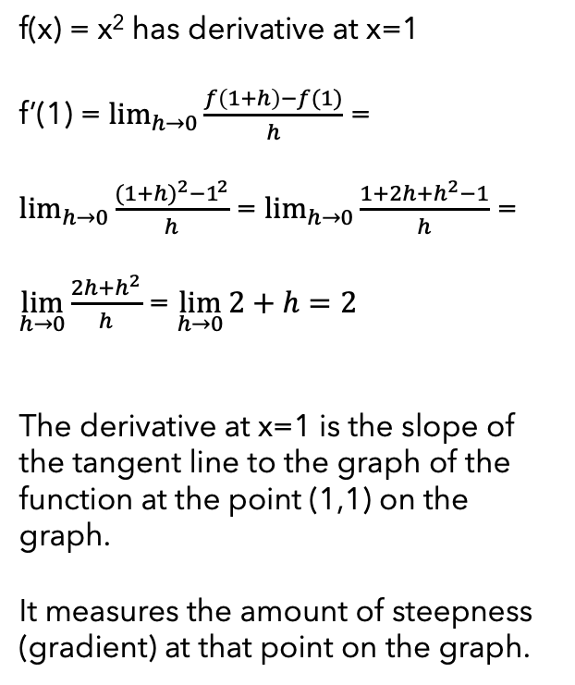
Example: derivative at a point
f(x) = x² has derivative at x=1
f’(1) = $\lim_{h→0}{\frac{f\left(1+h\right)−f(1)}{h}}$ =
$\lim_{h→0}{\frac{{(1+h)}^{2}−1^{2}}{h}}$ = $\lim_{h→0}{\frac{1+2h+h^{2}−1}{h}}$ =
$\lim_{h→0}{\frac{2h+h^{2}}{h}}$ = $\lim_{h→0}{2+h=2}$
The derivative at x=1 is the slope of the tangent line to the graph of the function at the point (1,1) on the graph.
It measures the amount of steepness (gradient) at that point on the graph.

Slide 4
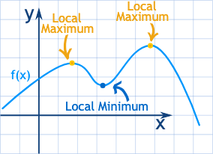
Local min/max of a function of a single variable
The derivative of a function at a point may or may not exist.
If the derivative exists at a local minimum or maximum, then it must be zero (the tangent line is horizontal).
Local minimum (maximum) may or may not be the smallest (largest) value of the function.
Local minima or maxima are found where the derivative is zero or where it does not exist.

Slide 5
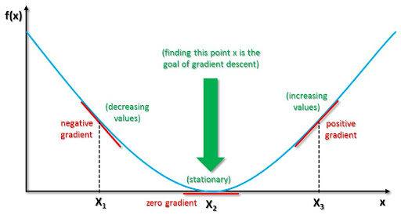
Minimize the Loss Function
In machine learning, the training of a neural network is done by minimizing the loss/error function with respect to the model parameters.
If f(x) is the loss function of a neural network with a single parameter x, then a local minimum of f(x), if it exists, occurs where the derivative (gradient) is zero. (f’(x)=0)
Finding the root(s) of f’(x)=0 is not generally attainable by an algebraic formula especially if there are several parameters.
Rather, we use a step-by-step approach/descent to a local minimum using the gradient.
If we start at x₁ where the gradient is negative, we move to the right towards x₂. From x₃, we move to the left towards x₂ where the min is.

Slide 6
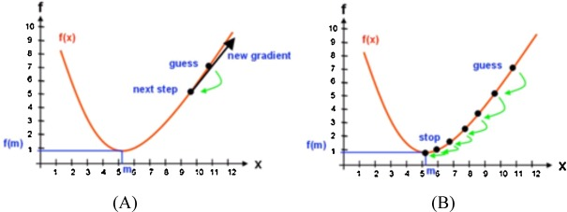



Implementing gradient descent for a function of a single variable
If f represents a loss (cost or error) function of a single parameter x and has a local minimum value at some value x=m (generally not known) then, starting at a random value x=guess, we apply gradient descent to approach x=m by finding a new guess using the formula: new guess = old guess – (learning rate) x gradient
For small learning rate $∈,$
f(x-$∈sign(f^{′}\left(x\right)))<f(x)$
f(x-$∈sign(f^{′}\left(x\right)))≈f(x)−∈|f′(x)|$

Slide 7
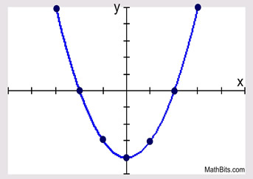
Example of Gradient Descent
Let f(x) = x² – 4 be a function of a single parameter x. Then f’(x) = 2x.
Then the function f has a minimum value -4 at
x = 0.
Implement gradient descent starting with the guess x = 3 using learning rate 0.2.
Guessed min = f(3)= 9-4=5
Then the new guess x₁ = 3 – 0.2 f’(3) =
3-0.2(6)= 1.8. New guessed min=f(1.8)=-0.76
Continue: next guess x₂ = x₁ – 0.2f’(x₁) =
1.8 – 0.2(3.6) = 1.08. New guessed min=f(1.08)= -2.8336
Then x₃ = x₂-0.2 f’(x₂)=1.08-0.2(2.16)= 0.648
New guessed min=f(0.648)=-3.58. the guessed minima are inching closer to the real minimum.

Slide 8
Rules of Differentiation
Function f Derivative f’
Constant f(x) = c f’(x) = 0
Sum f(x) = g(x) + h(x) f’(x) = g’(x) + h’(x)
Product f(x) = g(x) h(x) f’(x) = g(x)h’(x) +g’(x)h(x)
Quotient $f\left(x\right)=\frac{g(x)}{h(x)}$ $f^{′}\left(x\right)=\frac{g^{′}\left(x\right)h\left(x\right)−g\left(x\right)h^{′}(x)}{{(h\left(x\right))}^{2} }$
Power $f\left(x\right)= x^{r}$ with r$≠0.$ $f^{′}\left(x\right)=r x^{r−1}$
Exponential $f\left(x\right)= e^{x}$ $f^{′}\left(x\right)= e^{x}$
Chain Rule $f\left(x\right)=g\left(h\left(x\right)\right)$ $f^{′}\left(x\right)=g^{′}\left(h\left(x\right)\right)h′(x)$

Slide 9
Chain Rule of differentiation
The Chain rule of differentiation plays a prominent role in the training phase of machine learning.
The derivative of a composition of functions requires the chain rule:
(g(f(x))′=g′(f(x))∙f′(x)
F(x)=g(f(x))
X=1
f(1)
F(1)=g(f(1))
f
g
F
Upstream gradient = (downstream gradient)(local gradient)
F’(1)=f’(1) g’(f(1))

Slide 10
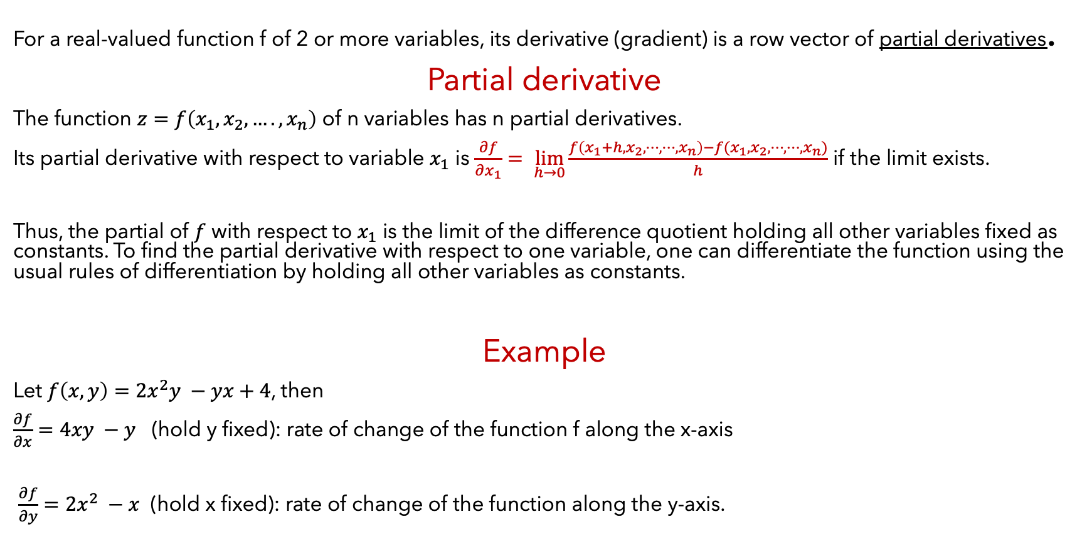
Multivariable case
For a real-valued function f of 2 or more variables, its derivative (gradient) is a row vector of partial derivatives.
Partial derivative
The function $z=f\left(x_{1},x_{2},….,x_{n}\right)$ of n variables has n partial derivatives.
Its partial derivative with respect to variable $x_{1}$ is $\frac{∂f}{∂x_{1}}= \lim_{h→0}{\frac{f\left(x_{1}+h, x_{2},⋯,⋯,x_{n}\right)−f(x_{1},x_{2},⋯,⋯,x_{n})}{h}}$ if the limit exists.
Thus, the partial of $f$ with respect to $x_{1}$ is the limit of the difference quotient holding all other variables fixed as constants. To find the partial derivative with respect to one variable, one can differentiate the function using the usual rules of differentiation by holding all other variables as constants.
Example
Let $f\left(x, y\right)=2x^{2}y −yx+4$, then
$\frac{∂f}{∂x}=4xy −y$ (hold y fixed): rate of change of the function f along the x-axis
$\frac{∂f}{∂y}=2x^{2} −x$ (hold x fixed): rate of change of the function along the y-axis.

Slide 11
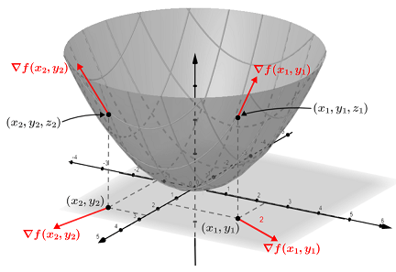
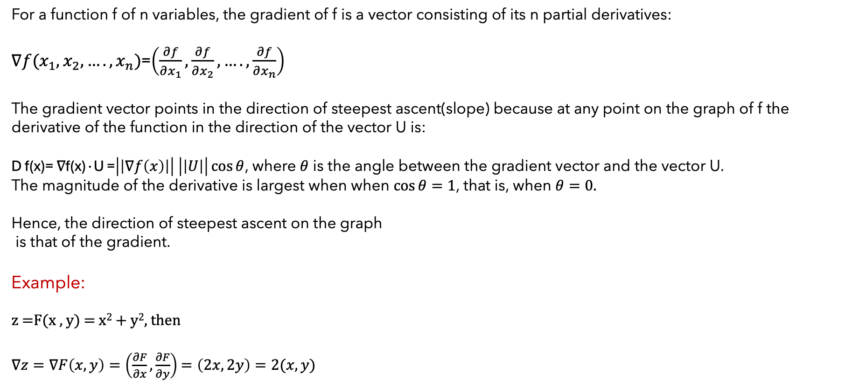
The gradient vector
For a function f of n variables, the gradient of f is a vector consisting of its n partial derivatives:
$∇f(x_{1},x_{2}, ….,x_{n})$=$\left(\frac{∂f}{∂x_{1}},\frac{∂f}{∂x_{2}}, …., \frac{∂f}{∂x_{n}}\right)$
The gradient vector points in the direction of steepest ascent(slope) because at any point on the graph of f the derivative of the function in the direction of the vector U is:
D f(x)= ∇f(x)∙U =$\left|\left|∇f\left(x\right)\right|\right| \left|\left|U\right|\right|\cos{θ}$, where $θ$ is the angle between the gradient vector and the vector U.
The magnitude of the derivative is largest when when $\cos{θ=1}$, that is, when $θ=0.$
Hence, the direction of steepest ascent on the graph
is that of the gradient.
Example:
z =F(x , y) = x² + y², then
$∇z=∇F\left(x,y\right)=\left(\frac{∂F}{∂x}, \frac{∂F}{∂y}\right)$ $=\left(2x, 2y\right)=2(x, y)$

Slide 12
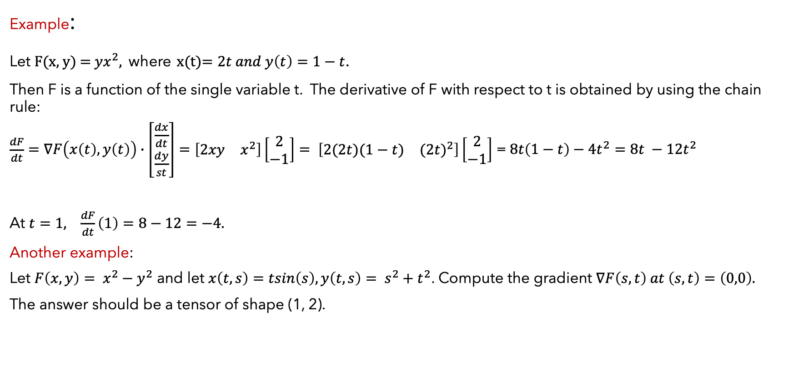
Chain Rule Applies for Several Variables
Example:
Let F(x, y) = ${yx}^{2}$, where x(t)$=2t and y\left(t\right)=1−t$.
Then F is a function of the single variable t. The derivative of F with respect to t is obtained by using the chain rule:
$\frac{dF}{dt}=∇F\left(x\left(t\right), y\left(t\right)\right)∙\left[\begin{matrix}\frac{dx}{dt} \\ \frac{dy}{st}\end{matrix}\right]=\left[\begin{matrix}2xy & x^{2}\end{matrix}\right]\left[\begin{matrix}2 \\ −1\end{matrix}\right]= \left[\begin{matrix}2(2t)(1−t) & {(2t)}^{2}\end{matrix}\right]\left[\begin{matrix}2 \\ −1\end{matrix}\right]$ =$8t\left(1−t\right)−4t^{2}=8t −12t^{2}$
At $t=1, \frac{dF}{dt}\left(1\right)=8−12=−4.$
Another example:
Let $F\left(x,y\right)= x^{2}−y^{2}$ and let $x\left(t,s\right)=tsin\left(s\right), y\left(t,s\right)= s^{2}+t^{2}$. Compute the gradient $∇F\left(s,t\right) at \left(s,t\right)=\left(0,0\right).$
The answer should be a tensor of shape (1, 2).

Slide 13
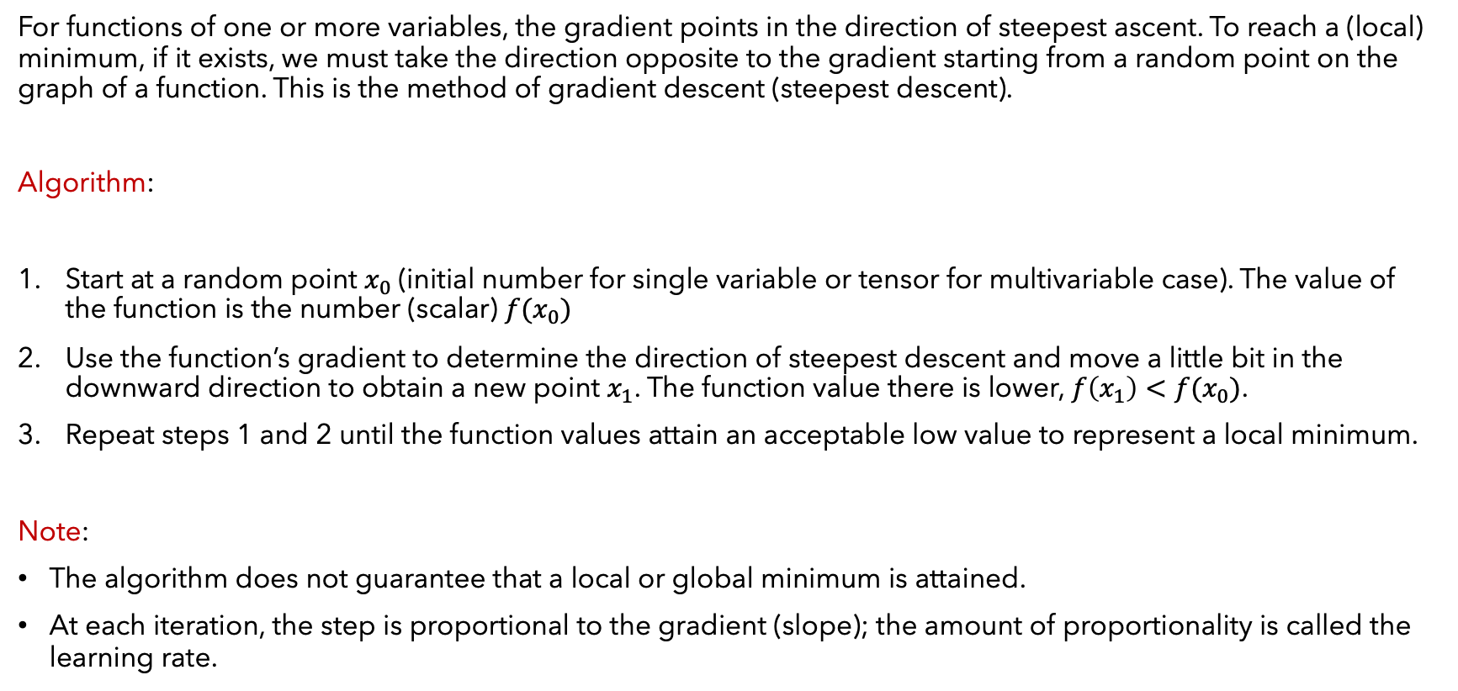
Gradient Descent Algorithm
For functions of one or more variables, the gradient points in the direction of steepest ascent. To reach a (local) minimum, if it exists, we must take the direction opposite to the gradient starting from a random point on the graph of a function. This is the method of gradient descent (steepest descent).
Algorithm:
Start at a random point $x_{0}$(initial number for single variable or tensor for multivariable case). The value of the function is the number (scalar) $f(x_{0})$
Use the function’s gradient to determine the direction of steepest descent and move a little bit in the downward direction to obtain a new point $x_{1}$. The function value there is lower, $f\left(x_{1}\right)<f(x_{0})$.
Repeat steps 1 and 2 until the function values attain an acceptable low value to represent a local minimum.
Note:
The algorithm does not guarantee that a local or global minimum is attained.
At each iteration, the step is proportional to the gradient (slope); the amount of proportionality is called the learning rate.

Slide 14
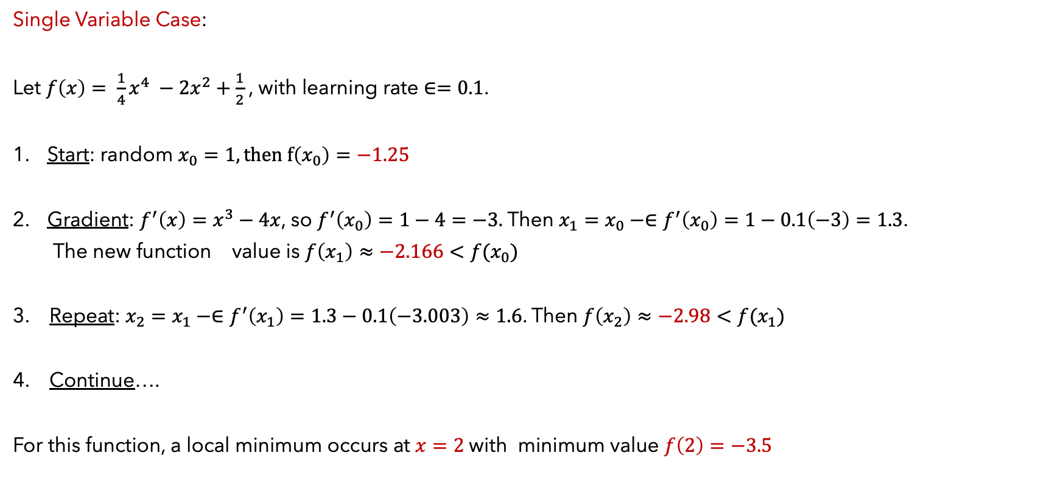
Application of the Gradient Descent Algorithm
Single Variable Case:
Let $f\left(x\right)= \frac{1}{4}x^{4} −2x^{2}+\frac{1}{2}$, with learning rate $∈=0.1$.
Start: random $x_{0}=1, then f\left(x_{0}\right)=−1.25$
Gradient: $f^{′}\left(x\right)=x^{3}−4x$, so $f^{′}\left(x_{0}\right)=1−4=−3.$ Then $x_{1}=x_{0}−∈f^{′}\left(x_{0}\right)=1−0.1\left(−3\right)=1.3$.
The new function value is $f\left(x_{1}\right)≈−2.166<f(x_{0})$
3. Repeat: $x_{2}=x_{1}−∈f^{′}\left(x_{1}\right)=1.3−0.1\left(−3.003\right)≈1.6$. Then $f\left(x_{2}\right)≈−2.98<f(x_{1})$
4. Continue….
For this function, a local minimum occurs at $x=2$with minimum value $f\left(2\right)=−3.5$

Slide 15
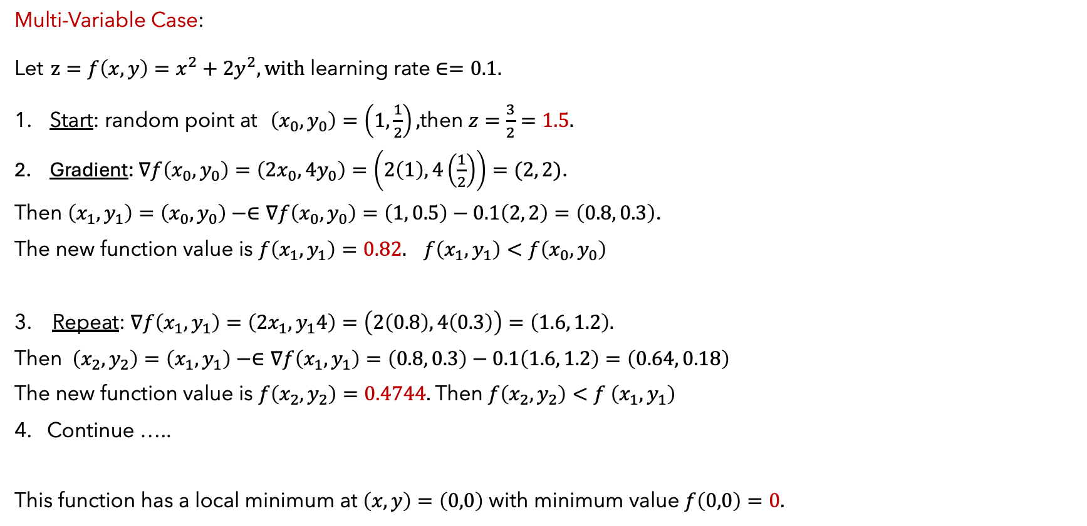
Application of the Gradient Descent Algorithm
Multi-Variable Case:
Let $z=f\left(x,y\right)=x^{2}+2y^{2}, with$ learning rate $∈=0.1.$
Start: random point at $\left(x_{0},y_{0}\right)=\left(1,\frac{1}{2}\right),$then $z=\frac{3}{2}=1.5.$
Gradient: $∇f\left(x_{0},y_{0}\right)=\left(2x_{0}, 4y_{0}\right)=\left(2\left(1\right), 4\left(\frac{1}{2}\right)\right)=(2, 2)$.
Then $\left(x_{1},y_{1}\right)=\left(x_{0},y_{0}\right)−∈∇f\left(x_{0},y_{0}\right)=\left(1, 0.5\right)−0.1\left(2, 2\right)=\left(0.8, 0.3\right)$.
The new function value is $f\left(x_{1},y_{1}\right)=0.82. f\left(x_{1},y_{1}\right)<f\left(x_{0},y_{0}\right)$
3. Repeat: $∇f\left(x_{1},y_{1}\right)=\left(2x_{1}, y_{1}4\right)=\left(2\left(0.8\right), 4\left(0.3\right)\right)=\left(1.6, 1.2\right).$
Then $\left(x_{2},y_{2}\right)=\left(x_{1},y_{1}\right)−∈∇f\left(x_{1},y_{1}\right)=\left(0.8, 0.3\right)−0.1\left(1.6, 1.2\right)=\left(0.64, 0.18\right)$
The new function value is $f\left(x_{2},y_{2}\right)=0.4744.$Then $f\left(x_{2},y_{2}\right)<f \left(x_{1},y_{1}\right)$
4. Continue …..
This function has a local minimum at $\left(x,y\right)=\left(0,0\right)$ with minimum value $f\left(0,0\right)=0.$

Slide 16
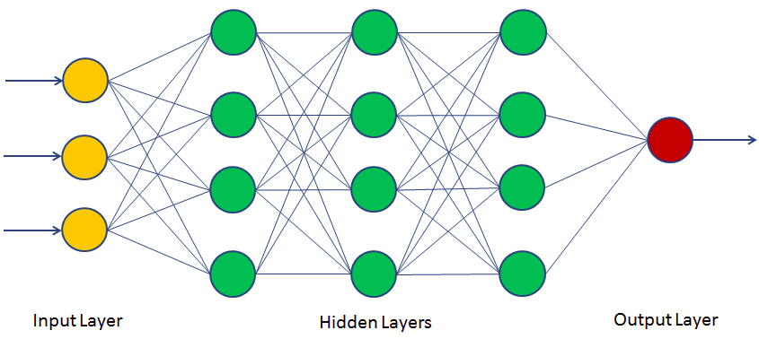
Gradients in Neural Network
In neural networks, the training of the model is done by minimizing the Loss/Cost/Error function with respect to the internal parameters of the model using the method of gradient descent.
The loss function measures the discrepancy between the output values and the expected values.

Slide 17








Differentiation through addition and multiplication gates
Each neuron is a function or a composition of functions. They can be represented by operation gates in a graph.
Examples: addition : z = f(x , y) = x + y
$\frac{∂z}{∂x}=\frac{∂z}{∂z}∙\frac{∂z}{∂x}=1∙1=1$
$z=x+y$
$\frac{∂z}{∂y}=\frac{∂z}{∂z}∙\frac{∂z}{∂y}=1∙1=1$ y
x
multiplication: z = f(x , y) = x y $z=x y$
$\frac{∂z}{∂x}=\frac{∂z}{∂z}∙\frac{∂z}{∂x}=1∙y=y$
$\frac{∂z}{∂y}=\frac{∂z}{∂z}∙\frac{∂z}{∂y}=1∙x=x$ y
x
$\frac{∂z}{∂x}$ =1
$$+$$
$$\frac{∂z}{∂z}=1$$
$$\frac{∂z}{∂y}=1$$
$$\frac{∂z}{∂x}=1∙y$$
*
$$\frac{∂z}{∂z}=1$$
$$\frac{∂z}{∂y}=1∙x$$

Slide 18
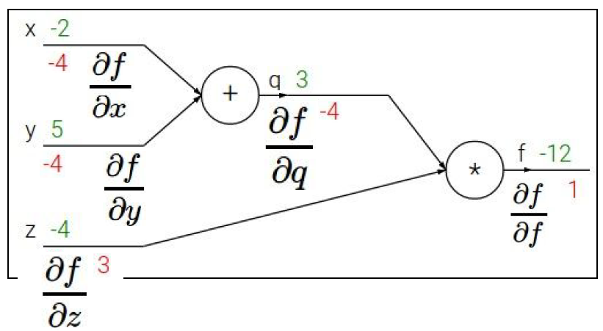
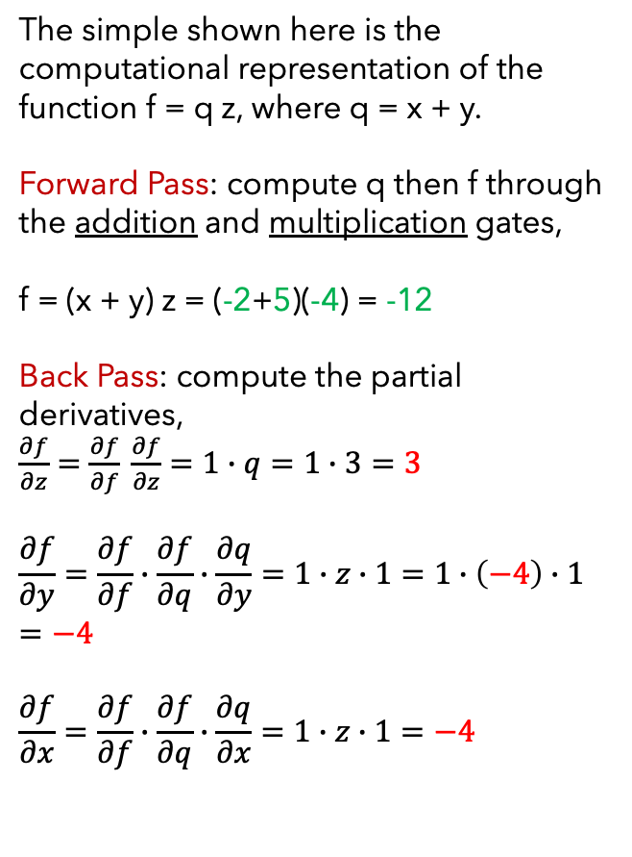
Computational Graph for Forward and Back Propagation
The simple shown here is the computational representation of the function f = q z, where q = x + y.
Forward Pass: compute q then f through the addition and multiplication gates,
f = (x + y) z = (-2+5)(-4) = -12
Back Pass: compute the partial derivatives,
$\frac{∂f}{∂z}=\frac{∂f}{∂f} \frac{∂f}{∂z}=1∙q=1∙3=3$
$$\frac{∂f}{∂y}=\frac{∂f}{∂f}∙\frac{∂f}{∂q}∙\frac{∂q}{∂y}=1∙z∙1=1∙\left(−4\right)∙1=−4$$
$$\frac{∂f}{∂x}=\frac{∂f}{∂f}∙\frac{∂f}{∂q}∙\frac{∂q}{∂x}=1∙z∙1=−4$$

Slide 19
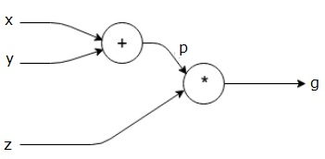
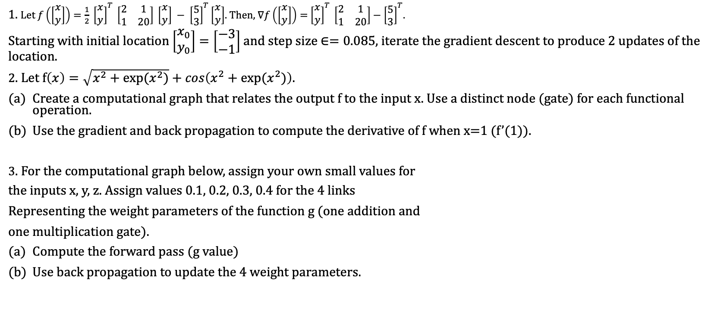
Homework
1. Let $f\left(\left[\begin{matrix}x \\ y\end{matrix}\right]\right)=\frac{1}{2} {\left[\begin{matrix}x \\ y\end{matrix}\right]}^{T} \left[\begin{matrix}2 & 1 \\ 1 & 20\end{matrix}\right] \left[\begin{matrix}x \\ y\end{matrix}\right] − {\left[\begin{matrix}5 \\ 3\end{matrix}\right]}^{T}\left[\begin{matrix}x \\ y\end{matrix}\right]$. Then, $∇f\left(\left[\begin{matrix}x \\ y\end{matrix}\right]\right)=$ ${\left[\begin{matrix}x \\ y\end{matrix}\right]}^{T} \left[\begin{matrix}2 & 1 \\ 1 & 20\end{matrix}\right]−{\left[\begin{matrix}5 \\ 3\end{matrix}\right]}^{T}$.
Starting with initial location $\left[\begin{matrix}x_{0} \\ y_{0}\end{matrix}\right]=\left[\begin{matrix}−3 \\ −1\end{matrix}\right]$ and step size $∈=0.085$, iterate the gradient descent to produce 2 updates of the location.
2. Let f$\left(x\right)=\sqrt{x^{2}+exp⁡(x^{2})}+cos\left(x^{2}+exp⁡(x^{2})\right)$.
Create a computational graph that relates the output f to the input x. Use a distinct node (gate) for each functional operation.
Use the gradient and back propagation to compute the derivative of f when x=1 (f’(1)).
3. For the computational graph below, assign your own small values for
the inputs x, y, z. Assign values 0.1, 0.2, 0.3, 0.4 for the 4 links
Representing the weight parameters of the function g (one addition and
one multiplication gate).
Compute the forward pass (g value)
Use back propagation to update the 4 weight parameters.

Slide 20













4. Find the gradient of the function $f\left(x_{1},x_{2}\right)=3x_{1}^{2}+5e^{x_{2}}$.
5. Use the chain rule to write the formula for the gradient of the function $u=f(x, y, z)$ , where $x=x\left(a,b\right), y=y\left(a,b\right),$ and $z=z\left(a,b\right).$ Indicate the shape of $∇u\left(a,b\right).$
6. In the NN below, use small values for the inputs and parameters to compute the square error with sigmoid at hidden nodes.
Then find the gradient of the error function and update the 6 parameters.
$$w_{1}$$
$y_{1}$|𝜎
$$x_{1}$$
$$w_{2}$$
$$w_{5}$$
$$y_{3}$$
$$w_{3}$$
$$E(y_{3})$$
$$x_{2}$$
$y_{2}|$𝜎
$$w_{6}$$
$$w_{4}$$

